Slide 1
Com sci 102 project: blackjack
By Jarryd Geyer (G19G2085)
Ethan Sebakwane (G18S6973)
Wandile C (G18C4646)

Slide 2
Requirements and analysis

Slide 3
Resources
Time taken to plan and produce the product
The desktop/laptop computers necessary to create the program
Notepad++
Human resources – three students

Slide 4
Information
The project deadline is the 11th of October 2019.
The final product is to be a functioning card game – our game of choice being Blackjack

Slide 5
functionality
The program is a game designed to allow the player to play a virtual game of Blackjack against the computer.
It takes in text inputs from the player and outputs options and details of the rounds and games.
The game creates and saves scores and input names in a leaderboard file, updating and reorganising the ranks of the scores at the end of each game.

Slide 6
behaviour
The game will follow the rules of a specific variant of Blackjack
The player interacts with the game by being able to:
choose whether to hit, split, double down, stand a card
define the size of their bets
fold/forfeit and end the game
input their name to be saved in a leaderboard

Slide 7
performance
Run on command line or windows powershell
Valid user inputs only
All classes in the same directory

Slide 8
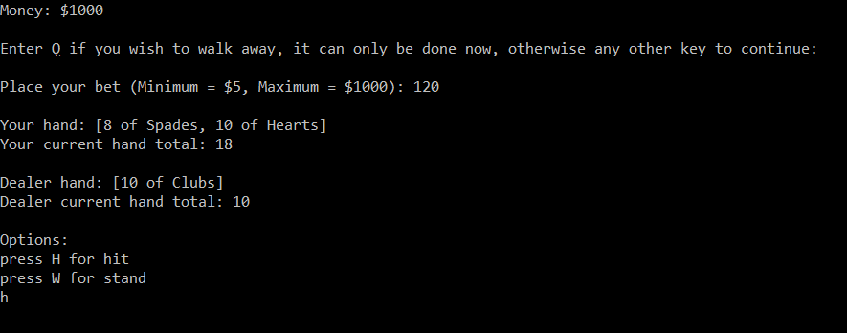
interfaces
The program makes use of a text-based interface, using characters to issue commands to the game

Slide 9
analysis
Deployment:
The program’s intended use would be in a recreational setting, given that it is a game.
Utilisation: How will various program components be used?
Class programming (one class uses another)
Mission Scenario: How will the program accomplish its objective?
Various methods and classes that fit together a working algorithm
Performance: what are the critical program parameters to accomplish the mission?
- Command line
- Valid inputs
- All classes present
Effectiveness: How effective must the system be in performing its mission?
Zero delays in the program execution

Slide 10
Design

Slide 11
risks
Medium rule set and short amount of time

Slide 12
Technologies: data structures
Linear Data Structures (Arrays, Linked Lists)
Numerical Data Structures
Primitive Data Types

Slide 13
Technologies: software architectures
Java
4 Classes: Deck, Card, Hand, Blackjack
Object Oriented
Leaderboard feature – creating, writing to, and reading a .csv file

Slide 14
Technologies: interface representation
This will be expanded upon in the Storyboard section (appears later)

Slide 15
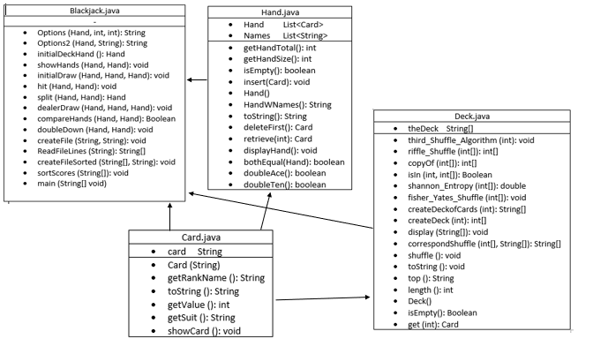
Technologies: algorithmic details
Object diagram(UML)

Slide 16
Time and budget
Time frame: 3 weeks

Slide 17
Design Approach
The Waterfall method is the best method to use as all requirements are known upfront and stable.
In the case of this project quality is more important than cost, as there is no budget, therefore this approach works well.
It is a new version of an existing product.
It is a small and straightforward project

Slide 18
Storyboard

Slide 19
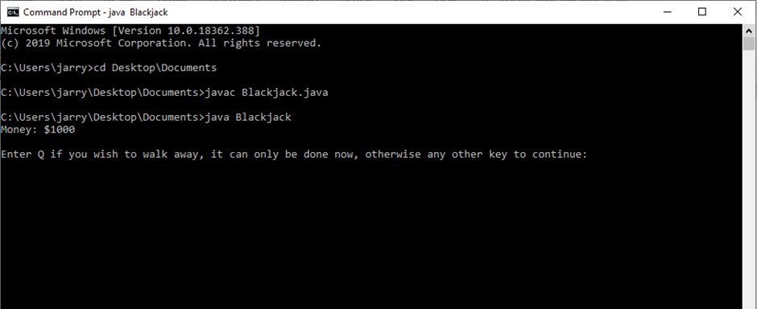
Compiling and running
Compiling and running the Blackjack.java program from the command line will see it print the player’s starting money
As well as prompting the player to press any key to continue or press Q to exit

Slide 20
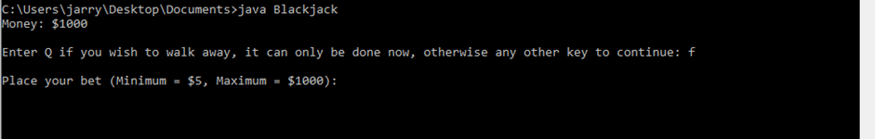
Placing bets
Should the player choose to not walk away and press any other key to continue, you will be prompted to add bets with a minimum of $5 and a maximum of $1000.
The maximum amount changes depending on how much cash you at that moment.

Slide 21
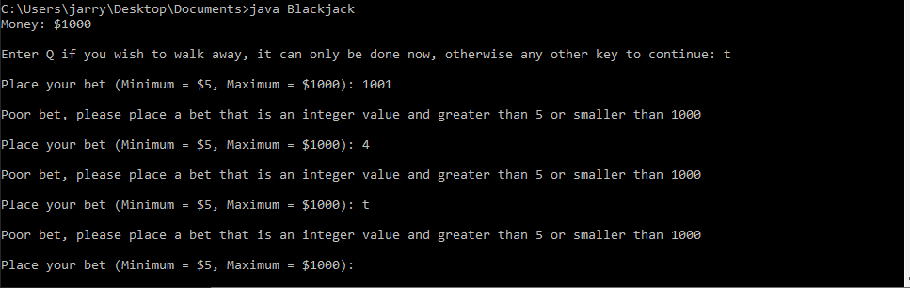
Poor entries for betting
Should the player input either an invalid amount or invalid input such as a number falling outside of the current range of betting or enter letter or word, the game will display a message prompting the player to enter a valid input.

Slide 22
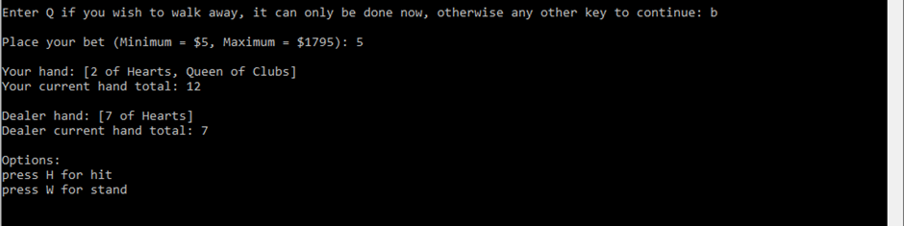
Regular round
This is a regular round with no split or double down options, with the options to hit or stand
The player chooses to hit when they want a higher hand total
The player can choose to stand when they are ready for the dealer to play

Slide 23
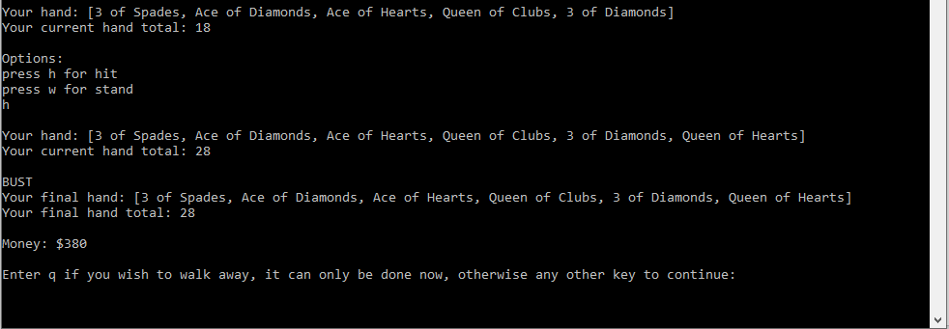
Losing a round
When the player loses a round, they are prompted with either the option to walk away or continue to the next round

Slide 24
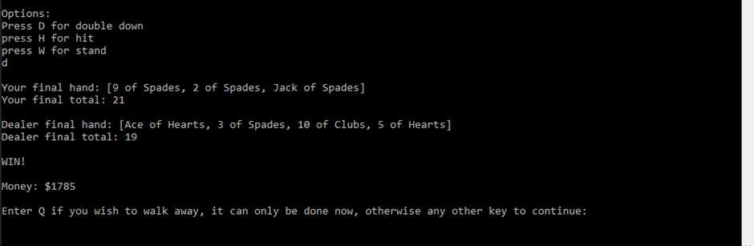
Winning a round
When the player wins a round, they are presented with the option to walk away with the money they have, ending the game, or play another round

Slide 25
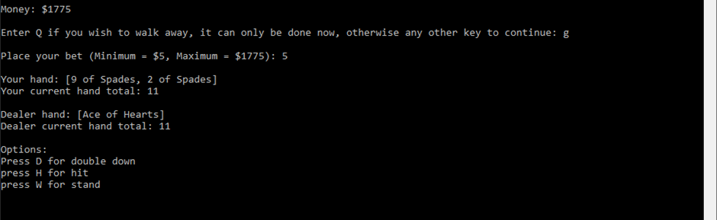
Double down option case
If the player has only 2 cards, totalling to 9, 10, or 11, the option to double down appears, allowing for the player to double their bet, accept one more card and be forced to stand

Slide 26
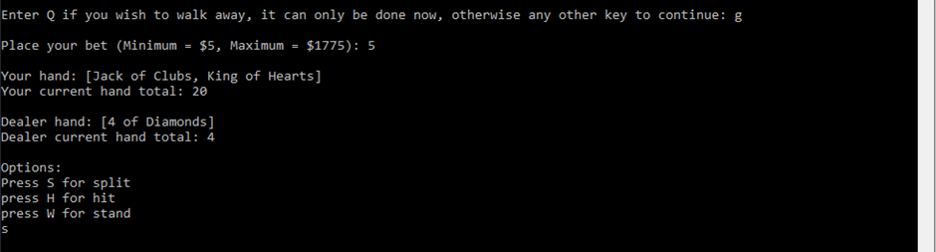
Split option case
If the player has only 2 cards, where both are aces or both are value 10s, the option to split appears, allowing for the player to double their bet and play two hands, chance of 4x pay-out!

Slide 27
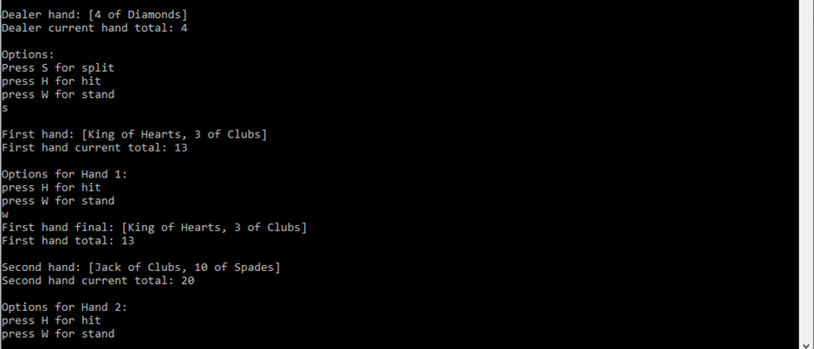
Playing on two hands after a split
When the player has chosen to split, their initial hand is split into 2, both new hands given an extra card, and they play each new hand as they would one

Slide 28
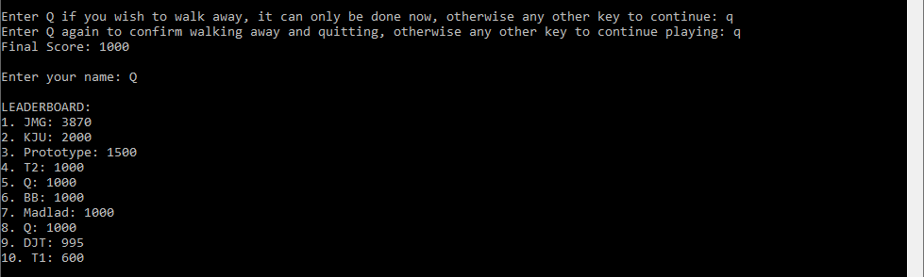
Walking away with money left, displaying the leaderboard
Should the player choose to walk away, they are prompted to confirm that they are walking away, then asked to input their name to be added to a leaderboard which contains their name and score.
The leaderboard appears whenever the game ends

Slide 29
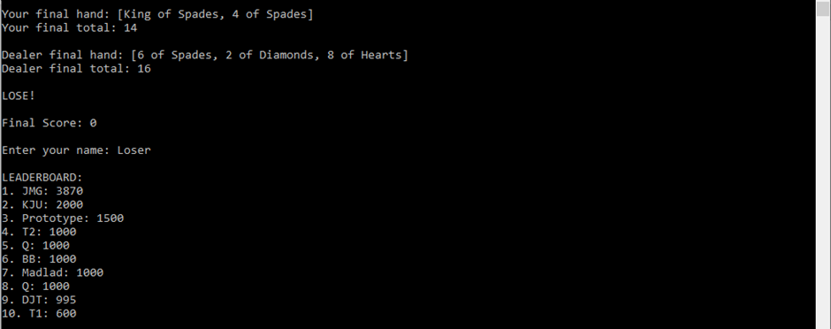
Game ending from running out of money
Should the player run out of money, the game immediately ends and they are presented with the leaderboard input prompt

Slide 30
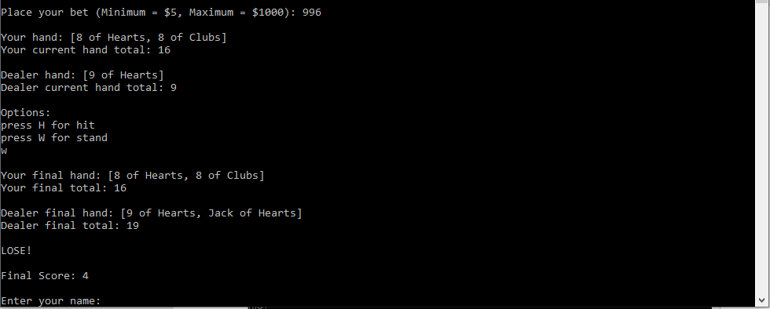
Game ending from having less money than minimum bet
Should the player have less money than the minimum amount required to place a bet, the game ends immediately and the player is presented with the leaderboard input prompt

